Slide 1
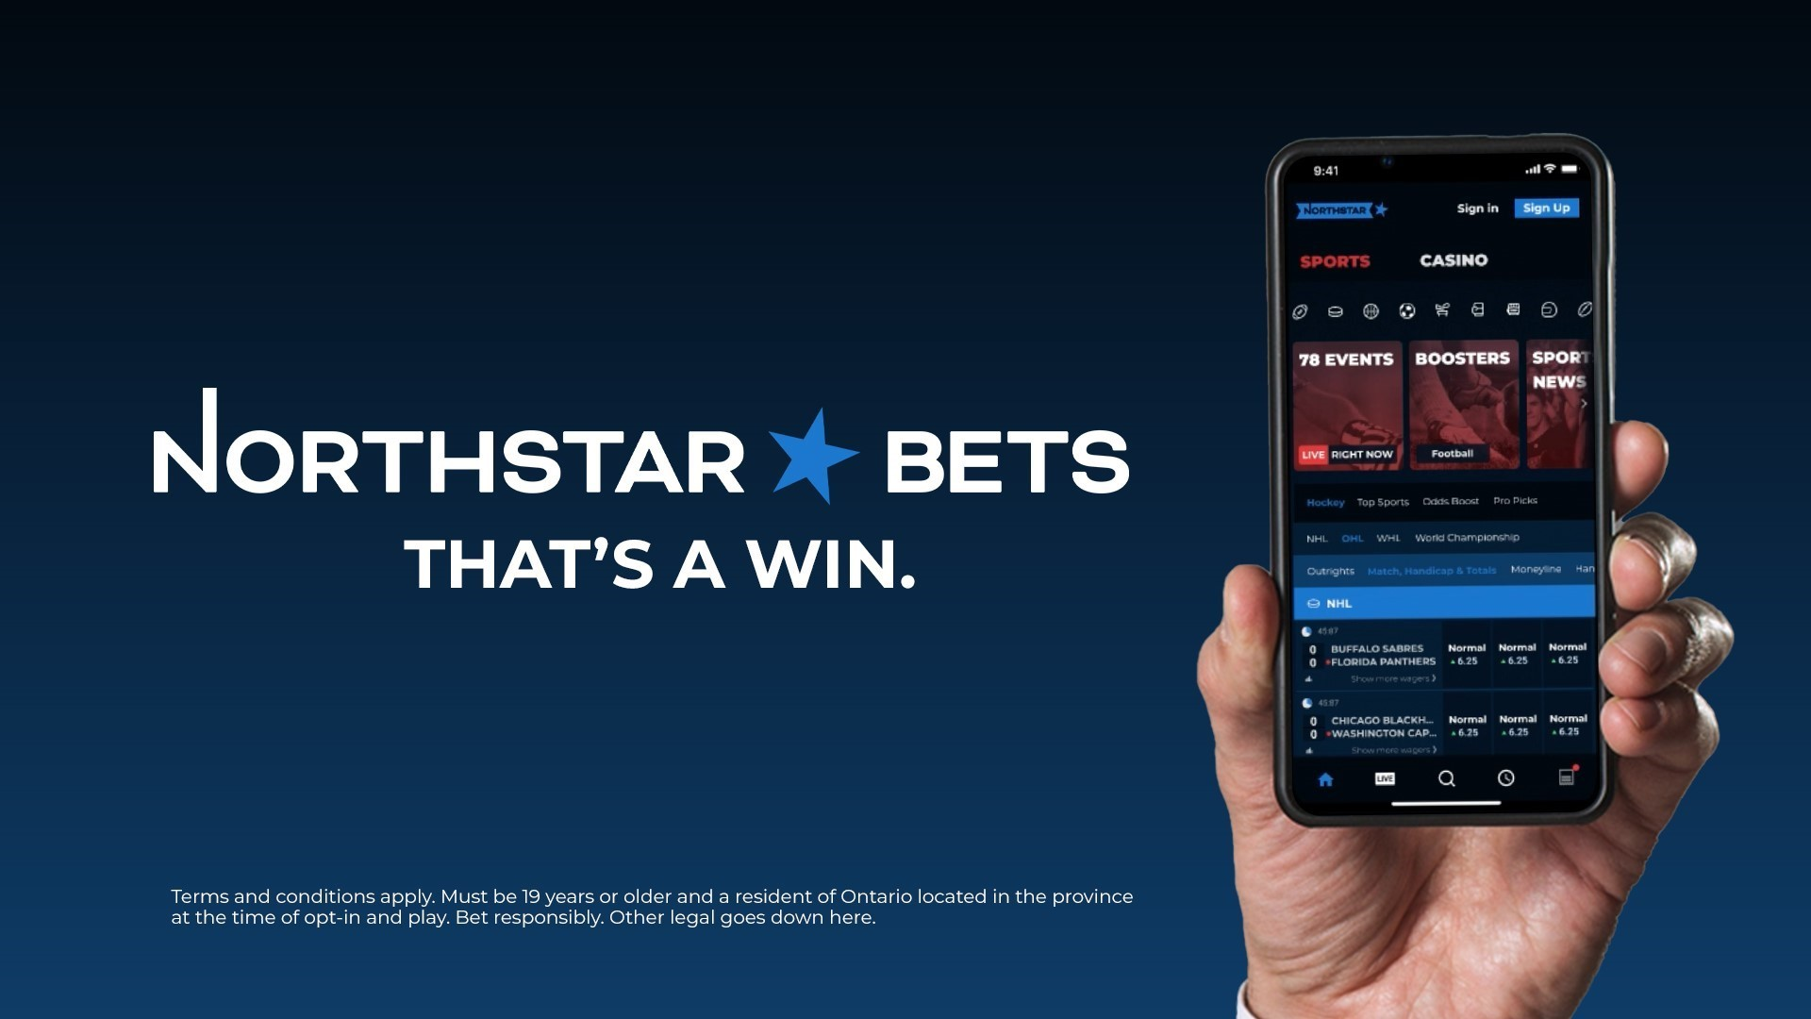
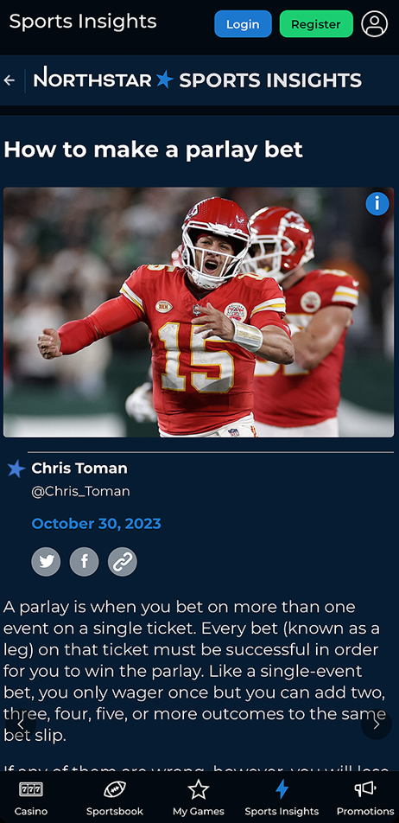



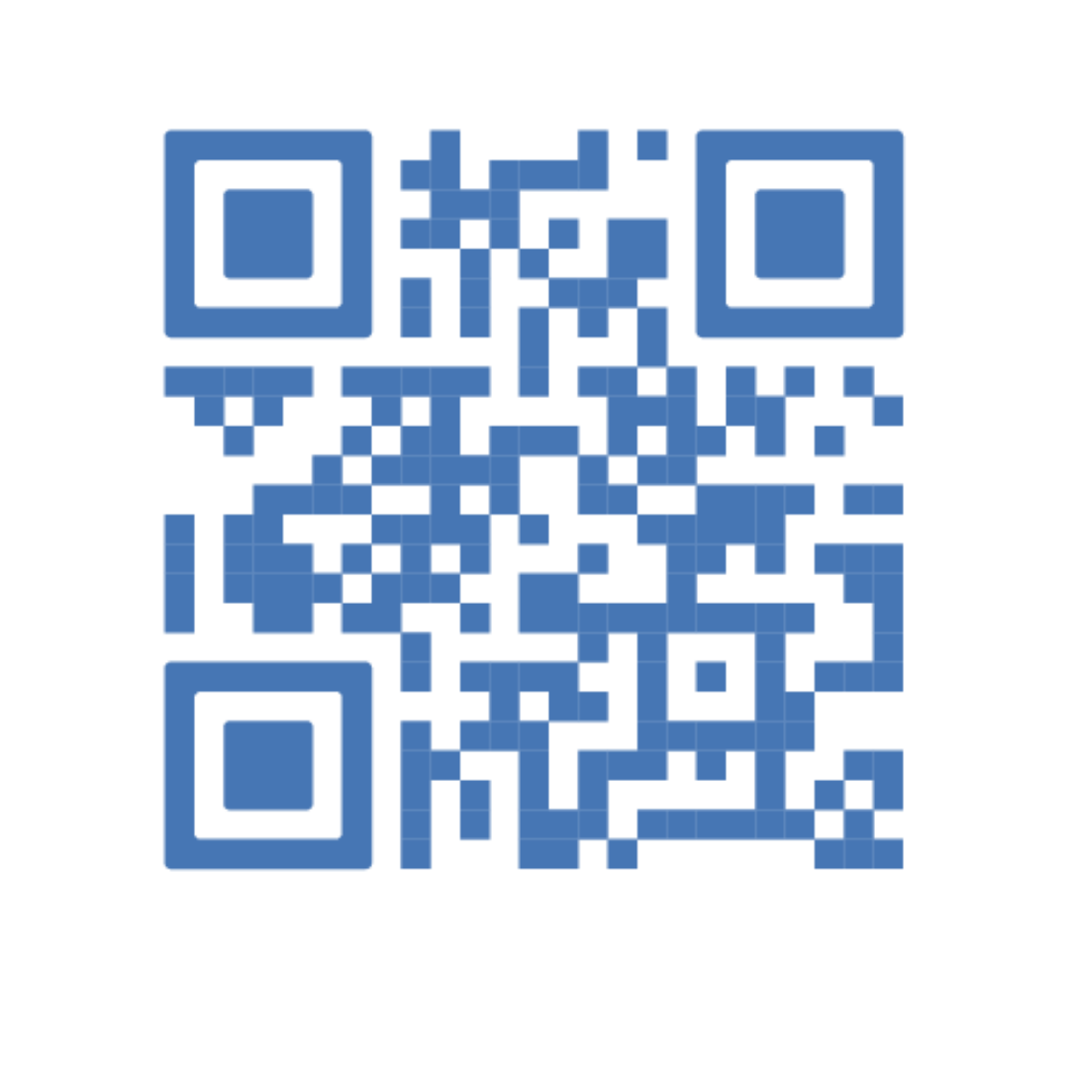
Investor Deck
February 2025
TSXV:BET OTCQB:NSBBF

Slide 2
DISCLAIMER
Cautionary Statement
The information contained in this presentation has been prepared by NorthStar Gaming Holdings Inc. (“NorthStar” or the “Company”) and contains confidential information pertaining to the business and operations of the Company. The information contained in this presentation: (a) is provided as at the date of this presentation, is subject to change without notice, and is based on publicly available information, internally developed data as well as third party information from other sources; (b) does not purport to contain all the information that may be necessary or desirable to fully and accurately evaluate an investment in the Company; (c) is not to be considered as a recommendation by the Company that any person make an investment in the Company; and (d) is for information purposes only. The information contained herein has been prepared for the purpose of providing interested parties with general information to assist them in their evaluation of the Company and this presentation should not be used for any other purpose. Where any opinion or belief is expressed in this presentation, it is based on certain assumptions and limitations and is an expression of present opinion or belief only. The third party information contained herein has not been independently verified. While the Company may not have verified the third party information, it believes that it obtained the information from reliable sources and has no reason to believe it is not accurate in all material respects. No warranties or representations can be made as to the origin, validity, accuracy, completeness, currency or reliability of such information. The Company disclaims and excludes all liability (to the extent permitted by law) for losses, claims, damages, demands, costs and expenses of whatever nature arising in any way out of or in connection with the information in this presentation, its accuracy, completeness or by reason of reliance by any person on any of it. This presentation may not be reproduced, in whole or in part, in any form or forwarded or further distributed to any other person. Any forwarding, distribution or reproduction of this document in whole or in part is unauthorized.
Cautionary Note Regarding Forward-Looking Information and Statements
This written and accompanying oral presentation contains "forward-looking information" within the meaning of applicable securities laws in Canada (“forward-looking statements”), which are provided for the purpose of presenting information about management’s current expectations and plans. Readers are cautioned that such statements may not be appropriate for other purposes. All statements in this presentation, other than statements of historical facts, with respect to the Company's objectives and goals, as well as statements with respect to its beliefs, plans, objectives, expectations, anticipations, estimates, and intentions, are forward-looking statements. Specific forward-looking statements in this presentation include, but are not limited to: expectations regarding certain of the Company's future results, including, among other things, revenue, expenses, revenue growth, capital expenditures, and operations; the total addressable market in Ontario and Canada (via the Company’s relationship with the Abenaki Council of Wolinak); expectations regarding the regulatory control and expansion of sports betting and online gaming in Canada and elsewhere and the related timing thereof and the Company’s intention and ability to participate in such markets; the impact of competition on the Company, including with respect to client acquisition costs and payback rates / ratios; the intentions of the Company with respect to future acquisitions; the Company entering into new markets; the development and function of the Company’s products and services, and the Company’s ability to market successfully to customers. Often, but not always, forward-looking statements can be identified by the use of words such as "plans", "expects", "is expected", "budget", "scheduled", "estimates", "continues", "forecasts", "projects", "predicts", "intends", "anticipates" or "believes", or variations of, or the negatives of, such words and phrases, or state that certain actions, events or results "may", "could", "would", "should", "might" or "will" be taken, occur or be achieved. This information is based on management’s opinions, estimates and assumptions that, while considered by NorthStar to be appropriate and reasonable, as of the date of this presentation, are subject to known and unknown risks, uncertainties, assumptions and other factors that may cause the actual results, levels of activity, performance, or achievements to be materially different from those expressed or implied by such forward-looking statements.
The Company believes the expectations reflected in the forward-looking statements contained herein are reasonable but no assurance can be given that these expectations will prove to be correct and such forward-looking statements included herein should not be unduly relied upon. Information contained in forward-looking statements in this presentation is provided as of the date of this presentation and the Company disclaims any obligation to update any forward-looking statements, whether as a result of new information or future events or results, except to the extent required by applicable securities laws.
Forward-looking statements contained in this presentation are based on certain assumptions and analyses made by the Company in light of its experience and perception of historical trends, current conditions and expected future developments and other factors it believes are appropriate and are subject to risks and uncertainties, including, but not limited to, risks and uncertainties concerning and related to the regulatory environment in Canada and abroad, and those factors referred to in the Company’s continuous disclosure filings with the securities regulatory authorities in Canada, including those factors discussed in greater detail under the “Risk Factors” section of the Company’s most recent annual information form, which is available under NorthStar’s profile on SEDAR+ at www.sedarplus.ca and on the Company’s website. Many of these risks are beyond the Company’s control.
The forward-looking statements contained herein, including such statements with regards to estimates of revenue, Total Wagers and Gross Gaming Revenue, are based upon certain assumptions that management believes are reasonable based on the information currently available to management. Such assumptions include, but are not limited to, assumptions regarding: (a) the demand for our products and services and fluctuations in future revenues; (b) sufficiency of current working capital to support future operating and working capital requirements; (c) equity and debt markets continuing to provide access to capital on acceptable terms; (d) general economic trends and conditions; (e) the expected actions of third parties; (f) the Company’s future growth prospects and business opportunities; (g) regulatory control and expansion of sports betting and online gaming in Canada and elsewhere and the Company’s intention and ability to participate in such markets; (h) expectations with respect to the renewal and/or extension of the Company’s permits, licenses and registrations; (i) capital cost of the Company’s expansion; (j) the competitive conditions in the industry in which the Company operates; (k) the applicable laws, regulations and any amendments thereof; (l) the grant and impact of any license, permit or registration for sports betting and online gaming or any amendments thereof; (m) the Company’s ability to comply with applicable governmental regulations and standards; (n) the Company’s success in implementing its strategies and achieving its business objectives; (o) the number of markets to be entered by the Company; (p) policies of enforcement; and (q) general business and economic conditions.
If any of these risks or uncertainties materialize, or if the opinions, estimates or assumptions underlying the forward-looking statements prove incorrect, actual results or future events might vary materially from those anticipated in the forward-looking statements. Although the Company has attempted to identify important risk factors that could cause actual results to differ materially from those contained in the forward-looking statements, there may be other risk factors not presently known to the Company or that the Company presently believes are not material that could also cause actual results or future events to differ materially from those expressed in such forward-looking statements. There can be no assurance that such information will prove to be accurate, as actual results and future events could differ materially from those anticipated in such information. No forward-looking statement is a guarantee of future results. Accordingly, you should not place undue reliance on forward-looking statements, which speak only as of the date made. The forward-looking statements contained in this presentation represent NorthStar’s expectations as of the date specified herein, and are subject to change after such date. However, the Company disclaims any intention or obligation or undertaking to update or revise any forward-looking statement whether as a result of new information, future events or otherwise, except as required under applicable securities laws.
All of the forward-looking statements contained in this presentation are expressly qualified by the foregoing cautionary statements.

Slide 3
DISCLAIMER
Non-IFRS Financial Measures
This presentation includes references to the Company’s “Gross Gaming Revenue” and “Total Wagers”, measures not prescribed by International Financial Reporting Standards (“IFRS”). Management uses certain non-IFRS financial measures and supplementary financial measures to evaluate the performance of the Company. The term “Gross Gaming Revenue” is a non-IFRS financial measure and the term "Total Wagers" is a non-IFRS supplementary financial measure. “Gross Gaming Revenue” and “Total Wagers”, as presented, may not be comparable to other similarly titled measures presented by other publicly-traded companies, as these measures do not have a standardized meaning under IFRS. Rather, these measures are provided as additional information to complement those IFRS measures by providing further understanding of our results of operations from management’s perspective and to discuss NorthStar’s financial outlook. Accordingly, these measures should not be considered in isolation nor as a substitute for analysis of the Company's financial information reported under IFRS. We believe that securities analysts, investors and other interested parties frequently use non-IFRS measures, including industry metrics, in the evaluation of companies in our industry. Management also uses non-IFRS measures and industry metrics in order to facilitate operating performance comparisons from period to period, the preparation of annual operating budgets and forecasts and to determine components of executive compensation. These measures have been applied consistently for all periods presented in this presentation.
Total Wagers
Total Wagers is calculated as the total amount of money bet by customers in respect of bets that have settled in the applicable period. Total Wagers does not include free bets or other promotional incentives, nor money bet by customers in respect of bets that are open at period end. Total Wagers is used to provide investors with supplemental measures of our operating performance and thus highlight trends in our business that may not otherwise be apparent when relying solely on IFRS measures.
Gross Gaming Revenue
Gross Gaming Revenue is calculated as dollar amounts bet by customers less the dollar amounts paid out to the customers in respect of such bets which have settled in the applicable period.
Profit/(loss) before marketing and other expenses
Profit/(loss) before marketing and other expenses is calculated as the gross profit margin less general and administrative expenses excluding non-cash items such as stock-based compensation. Proft/(loss) before marketing and other expenses is used to provide investors with supplemental measures of our operating performance and thus highlight trends in our business that may not otherwise be apparent when relying solely on IFRS measures.
A reconciliation of historical non-IFRS financial measures to the most directly comparable IFRS measures is available on the Company’s website. Additional information on non-IFRS financial measures may be found in the Company’s earnings news releases or in additional information on the Company’s website or SEDAR+ at www.sedarplus.ca.
Trademarks
This presentation may contain trademarks, service marks, trade names and copyrights of other companies, which are the property of their respective owners. Solely for convenience, some of the trademarks, service marks, trade names and copyrights referred to in this presentation may be listed without the TM, SM © or ® symbols, but we will assert, to the fullest extent under applicable law, the rights of the applicable owners, if any, to these trademarks, service marks, trade names and copyrights.
Unless otherwise specified, all dollar amounts in this presentation are expressed in Canadian dollars.

Slide 4
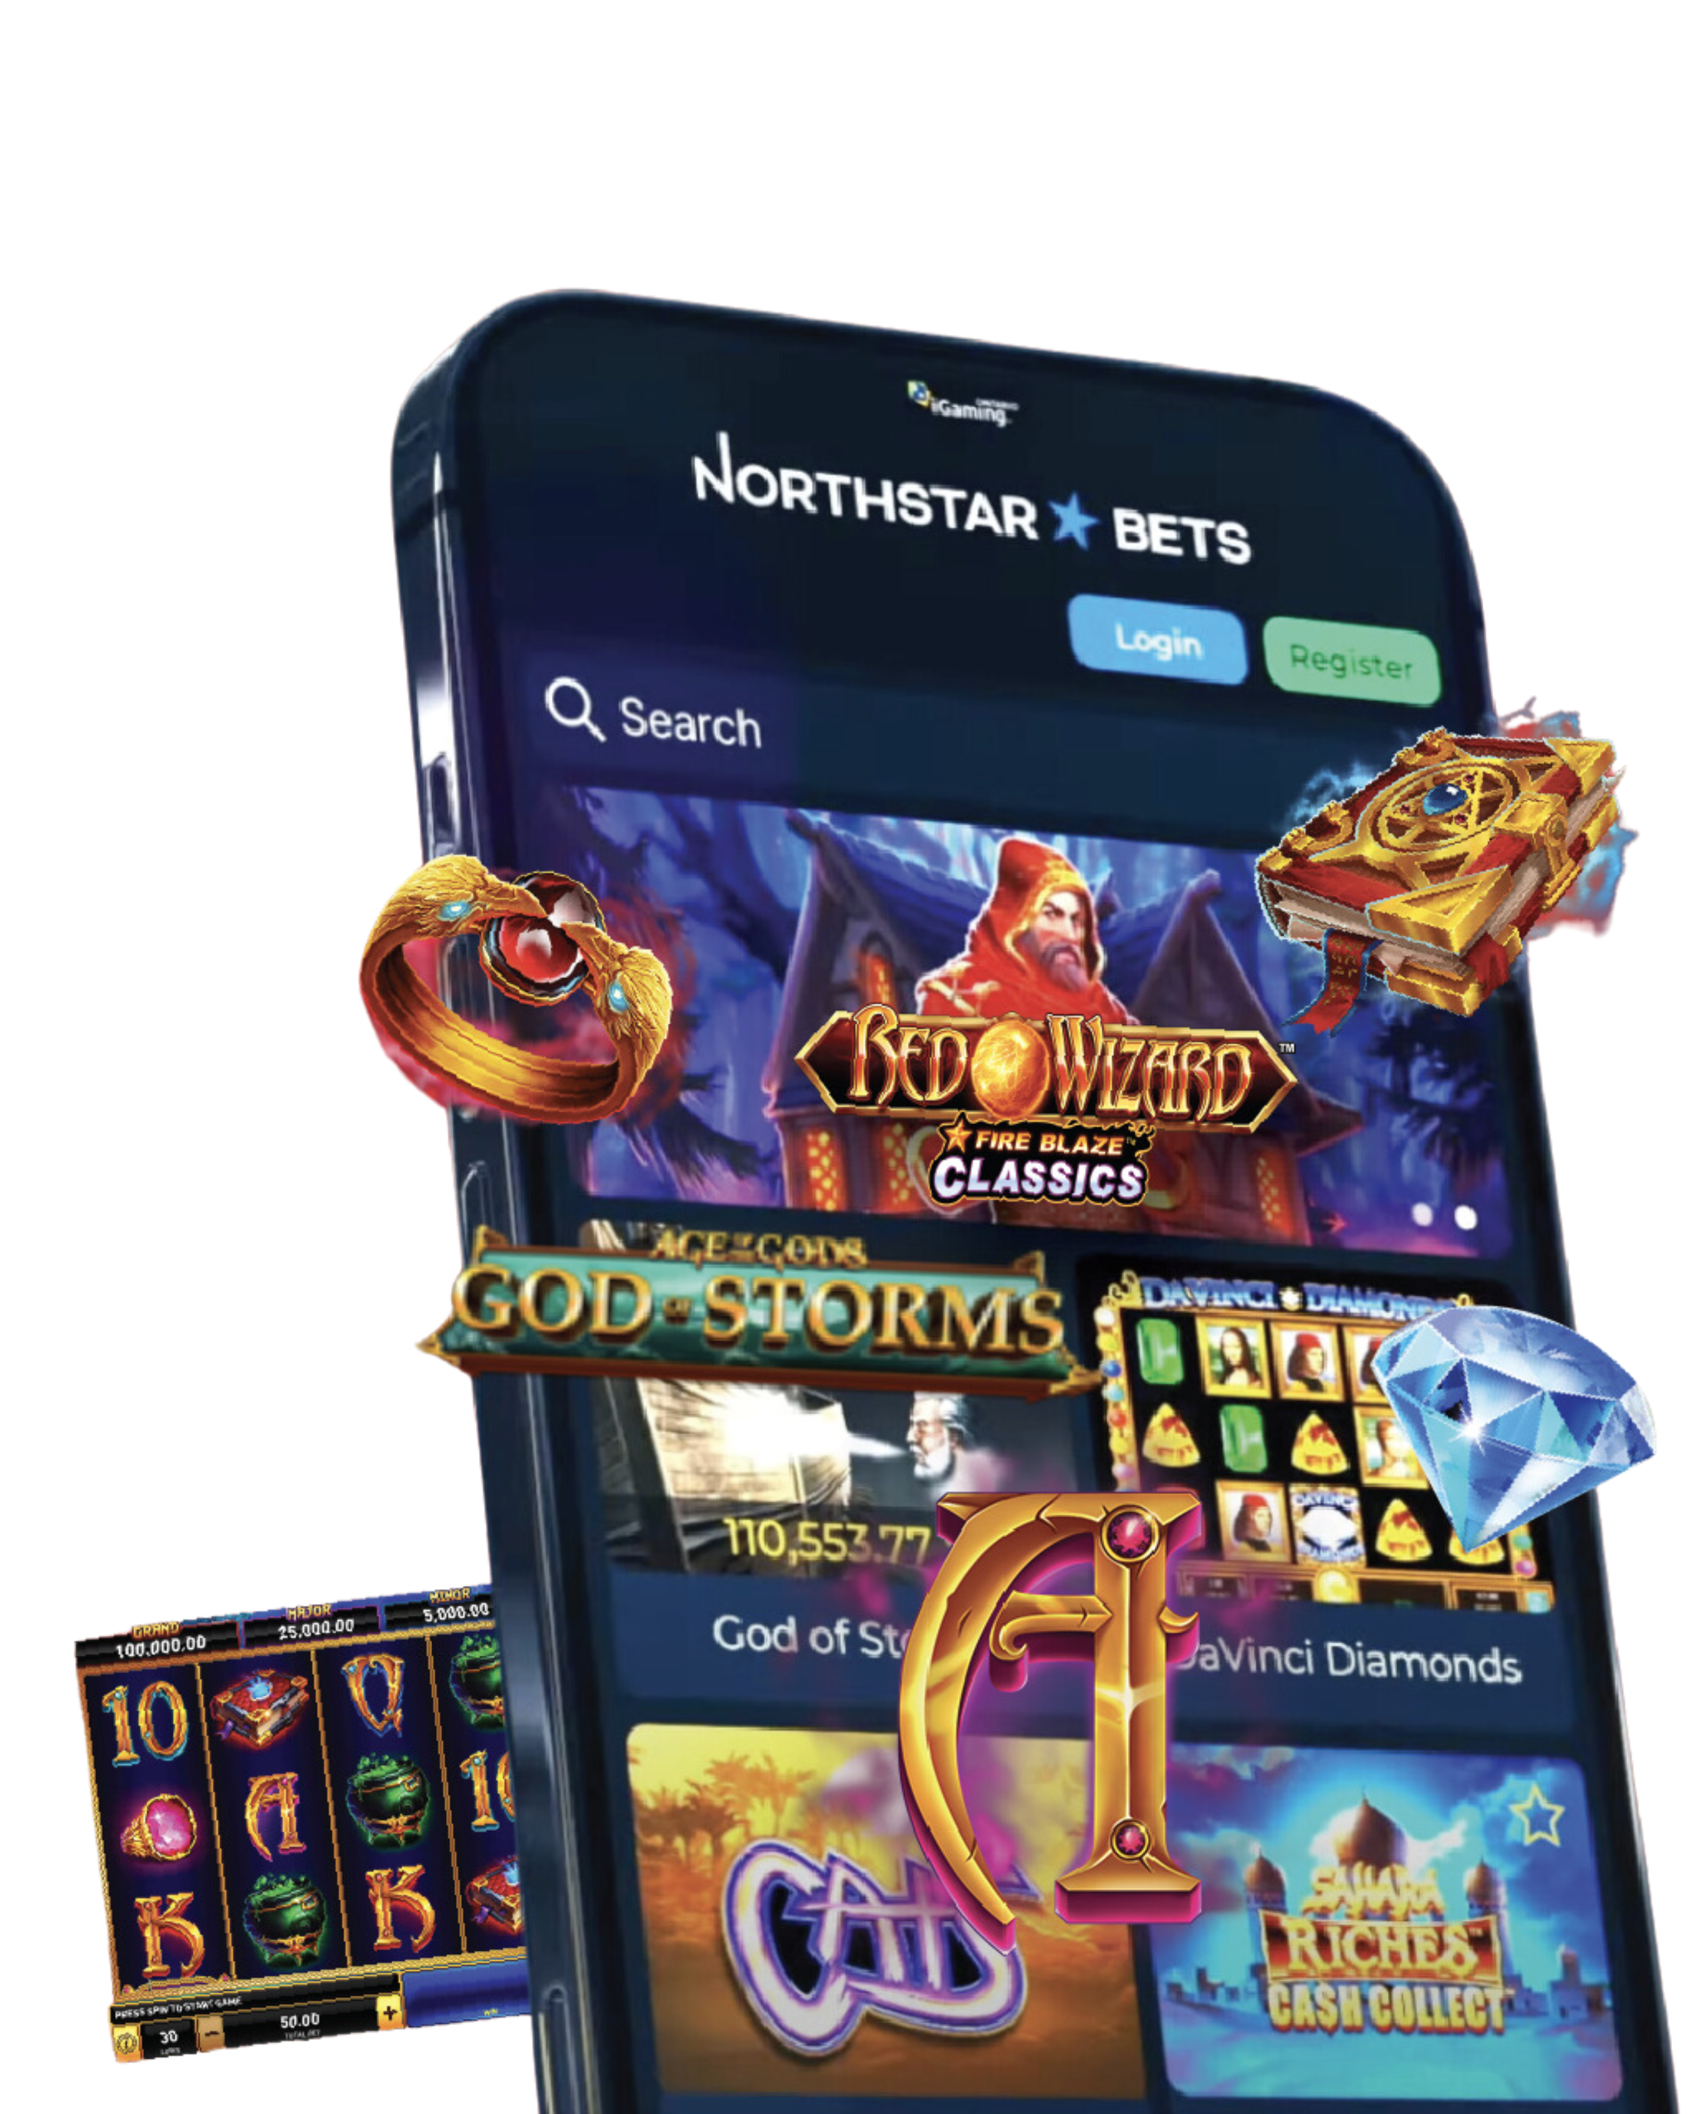
SPEARHEADING THE INTERSECTION OF
iGAMING AND MEDIA

Slide 5
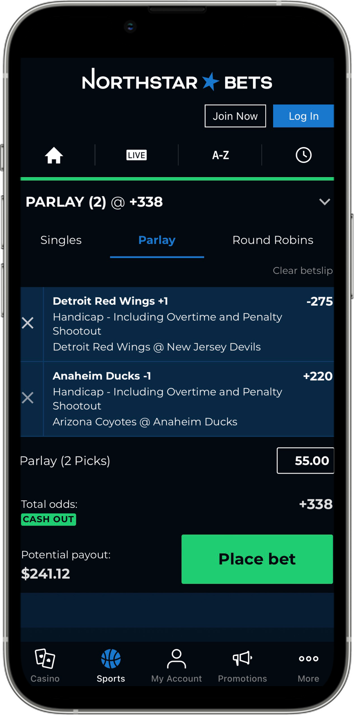
Investment Highlights
~C$8.5B Canadian TAM exposed to NorthStar brand, with Ontario’s regulated market launched in April 2022 and brand launch of NorthStarBets.com in November 2023*
01
02
Industry leading gaming content and technology
03
Funding in place to reach profitability based on current business platform
04
Experienced management team with local knowledge and insights targeting the Canadian audience
05
Differentiated positioning as a premium offering leading to a superior customer experience and user economics
06
Variable cost model fully aligning incentives amongst vendors and NorthStar
*NorthStarBets.com is owned and operated by the Conseil des Abénakis de Wôlinak and is licensed by the Kahnawake Gaming Commission, license number 00930. The trademark NORTHSTARBETS is used under license.
TAM Stands for Total Addressable Market

Slide 6
EXPANDING ADRESSABLE MARKET
    Ontario Market to Surpass C$3.0B for FY24 ¹
Projected Online Sports Betting and iGaming ² Market Size (2026E)
(C$ billions)
Alberta Opportunity
Canada’s 4th most populous province with a population
of ~4.4 million (3.3 million adults) with the youngest
average adult age in Canada (39 years old)
Highest per-capita GDP in Canada at ~$100K,
~50% higher than the Canadian average
Rest of Canada
Managed services provider to northstarbets.com,
an iGaming site owned and operated by the Conseil des Abénakis de Wôlinak
NorthStar
NorthStar well positioned to grow Ontario market share and across Canada
3% of market share would equate to >C$200M revenue
C$8.5B
Total Market
C$3.3B
Total Market
C$1B
Total Market3
Note: Canada estimates calculated internally based on extrapolating Ontario estimates to the entire country based on population
1. Source: PwC – Global Centre of Excellence for Betting & Gaming Lessons from Int’l Markets June 2022, Regulated Ontario Market Source: iGO Q2 2025 report
2. iGaming encompasses online casino games and other online non-sports betting wagers
3. JMP Industry Update June 26, 2024
.

Slide 7

Q4 2024 Results At a Glance*
Total Wagers
$303 million
Gross Gaming Revenue
$10 million
42%
32%
Revenue
$9.6 million
Gross Margin
$4.4 million
48%
76%
QUARTER 4
2024
* Preliminary numbers as per February 11, 2025, press release

Slide 8
TOTAL WAGERS¹
+51%
+42%
Three months ended December 31
Twelve months ended December 31
¹ Represents a Non-IFRS financial measure. See “Non-IFRS Financial Measures” above for more information.

Slide 9
REVENUE *
+53%
+48%
Three months ended December 31
Twelve months ended December 31
* Revenue, including managed services fees, net of bonuses, promotional costs and free bets

Slide 10
GROSS MARGIN
+76%
+76%
Three months ended December 31
Twelve months ended December 31
39%
46%
36%
42%
Percent of Revenue

Slide 11
CONSISTENT YEAR-OVER-YEAR GROWTH SINCE LAUNCH
* NorthStar Commenced Operations Q2 2022.
¹ Represents a Non-IFRS financial measure. See “Non-IFRS Financial Measures” above for more information.

Slide 12
DEMONSTRATING INCREASING OPERATING LEVERAGE
    Revenue and Gross Margin Growing Faster than
    Expenses
Revenue
Steady growth
Expenses
Relatively stable
Launch 2022
Building Scale
2023-24
Covering 2024
Overhead
Break-even
Profitability

Slide 13





LTM ACTIVITIES/ACHIEVEMENTS
Raised C$43.4M in long-term debt funding from Beach Point Capital Management LP
Gross Margin now covering overheads
Surpassed C$1.8B in wagers since the launch of NorthStarBets in May 2022
Product enhancements: Released NorthStar’s industry leading Insights 2.0 vertical; Expanded product offering with Blackjack Championship announced Q324
Geographic Expansion: beginning to solidify market growth into “rest-of-Canada”
with First Nations partnership

Slide 14
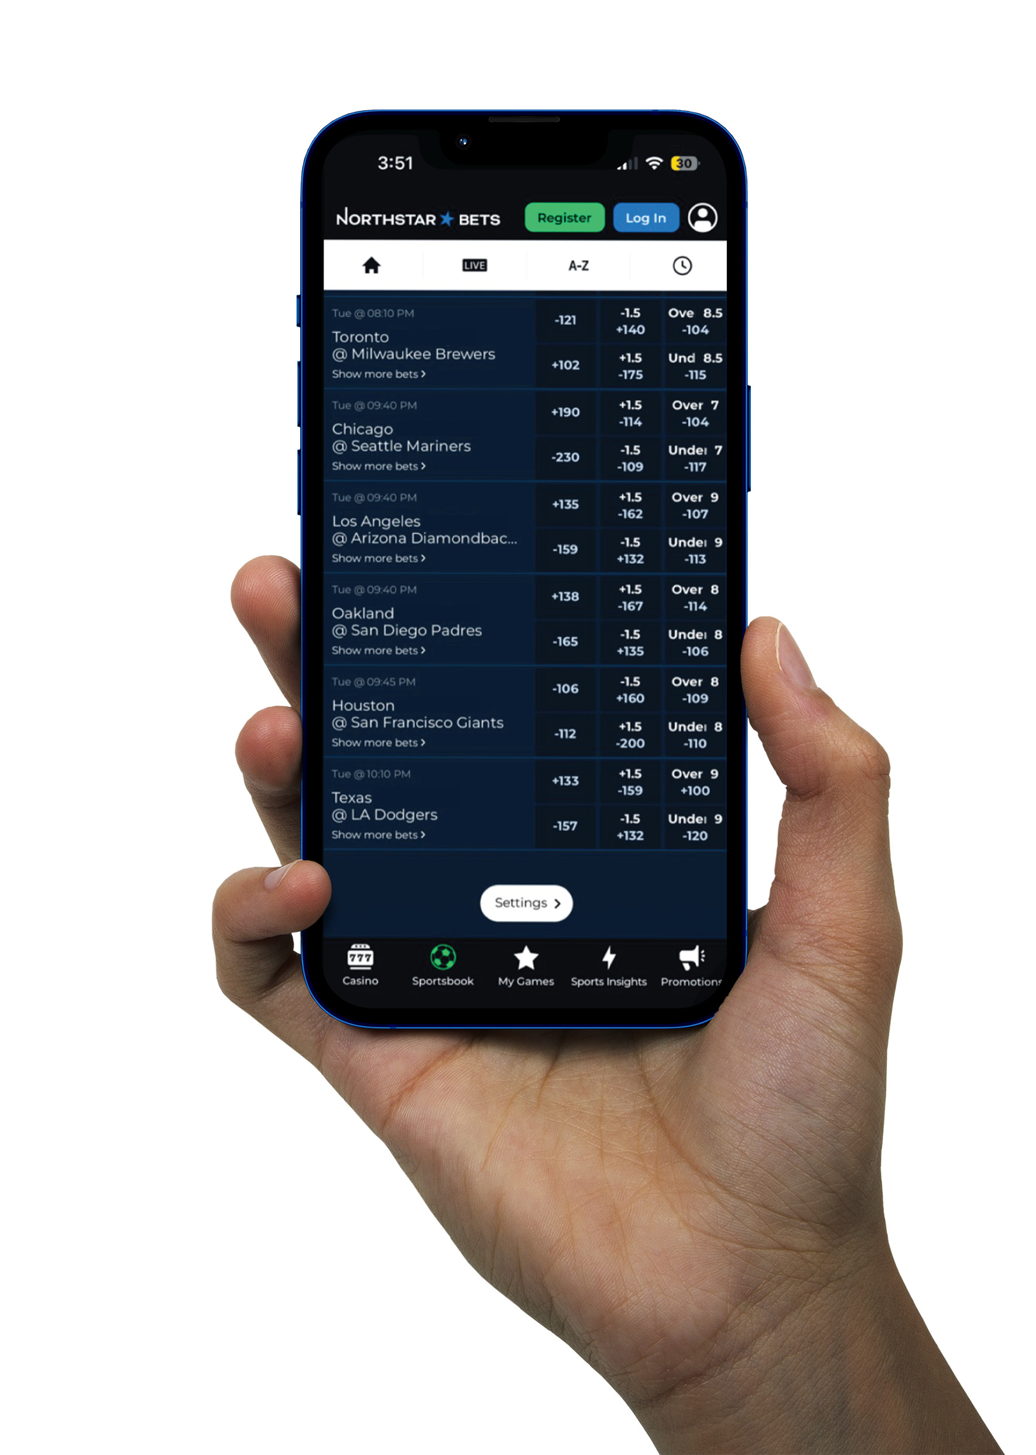
THE KEYS
TO OUR SUCCESS

Slide 15
OUR APPROACH TO PRODUCT INNOVATION
      Balance of "Consistently Better" and “Fundamentally Different”
      Better
      Optimization
      Reliability
      Trust
      Speed
      Simplicity
      Performance
      Different
      Differentiation
      Loyalty Driver
      Perceived Value
      Innovation
      Competitive
      Reason to Believe
Fundamentally
Different
Consistently
Better
Notes:
Milestones?

Slide 16
PREMIUM POSITIONING
YTD 24 vs. YTD 23*
  Differentiated positioning as a premium platform delivering a superior customer experience
Accelerating Casino revenue
+59%
Steady growth in active players
+32%
Higher new player values
+22%
*YTD numbers reflective as of Q3 2024

Slide 17

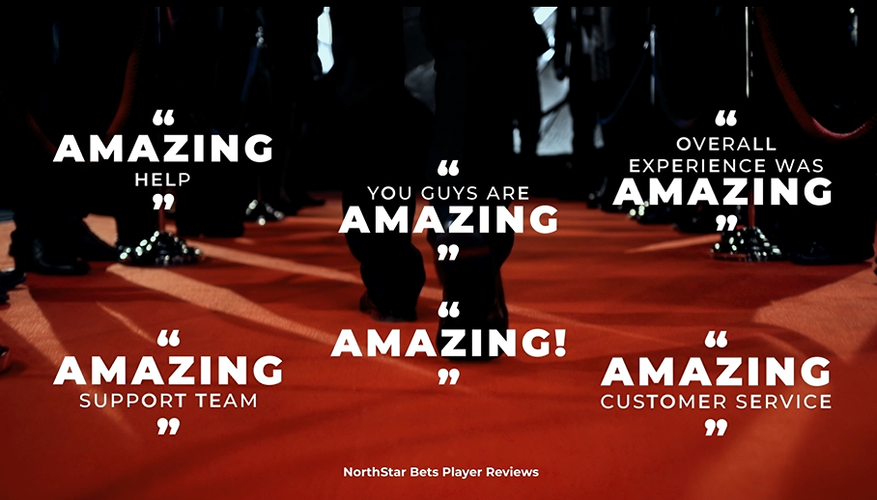
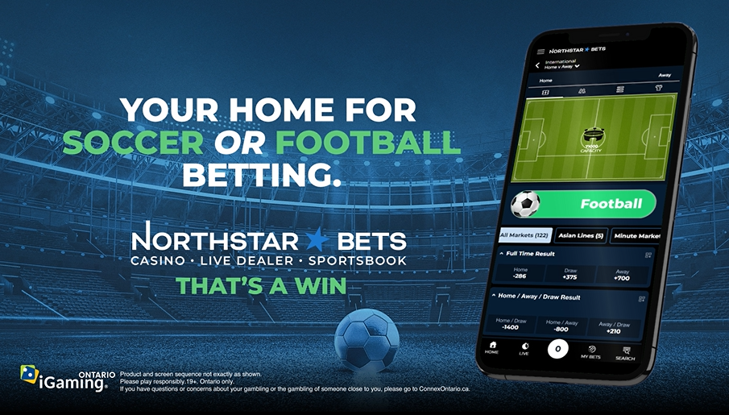
TARGETED MARKETING STRATEGIES
Ambition to disrupt with innovative locally focused marketing and promotions
Strategic focus on high-value Casino segments – Progressive Slots and Blackjack
Emphasis on first-class customer service USP paired with new products
Selective capitalization on Sports opportunities that yield high-value hybrid players
Focus on accelerating app acquisition to drive retention KPI
Targeting growing database via enhanced CRM activities
New player values and retention at all time high

Slide 18
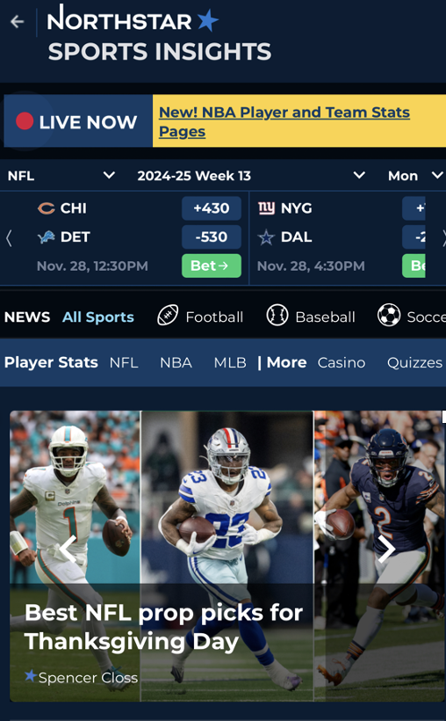
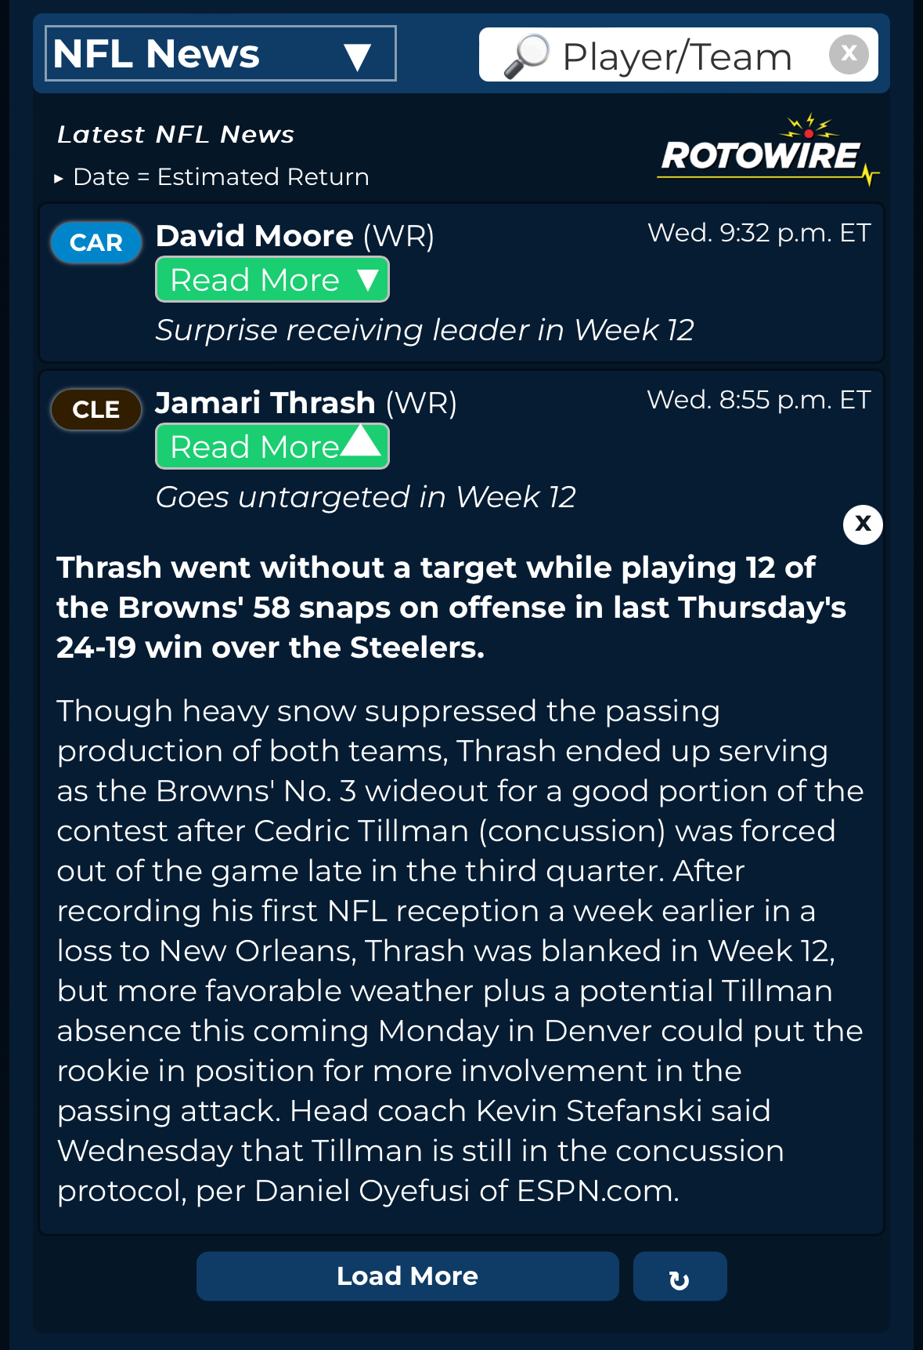
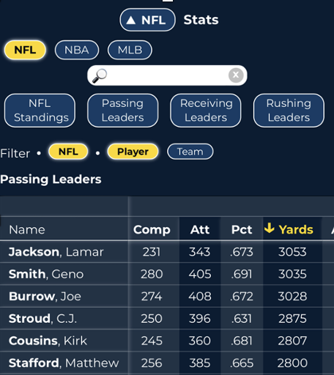
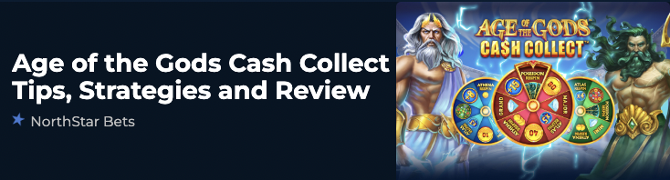
SPORTS INSIGHTS 2.0
      We’ve taken our industry-leading on-platform content vertical to new heights in 2024
Enhancements and new tools added to Sports Insights throughout 2024:
Improved UX/Home page redesign
Live scoreboard integrated with sportsbook
More casino content, including game reviews
Premium team and player stats (NFL, NBA, NHL, MLB)
Injury and player news feeds (NFL, NBA, NHL, MLB, EPL)
Sports Insights Users Drive Results:
      VIP Penetration: +13%
      Higher avg. total deposits: +58%
      Higher avg. casino turnover: +50%
      Higher avg. sports turnover: +138%
^{1.}. Calculated internally based on activity of registered players at northstarbets.ca who frequent Sports Insights vs. those who don’t..

Slide 19
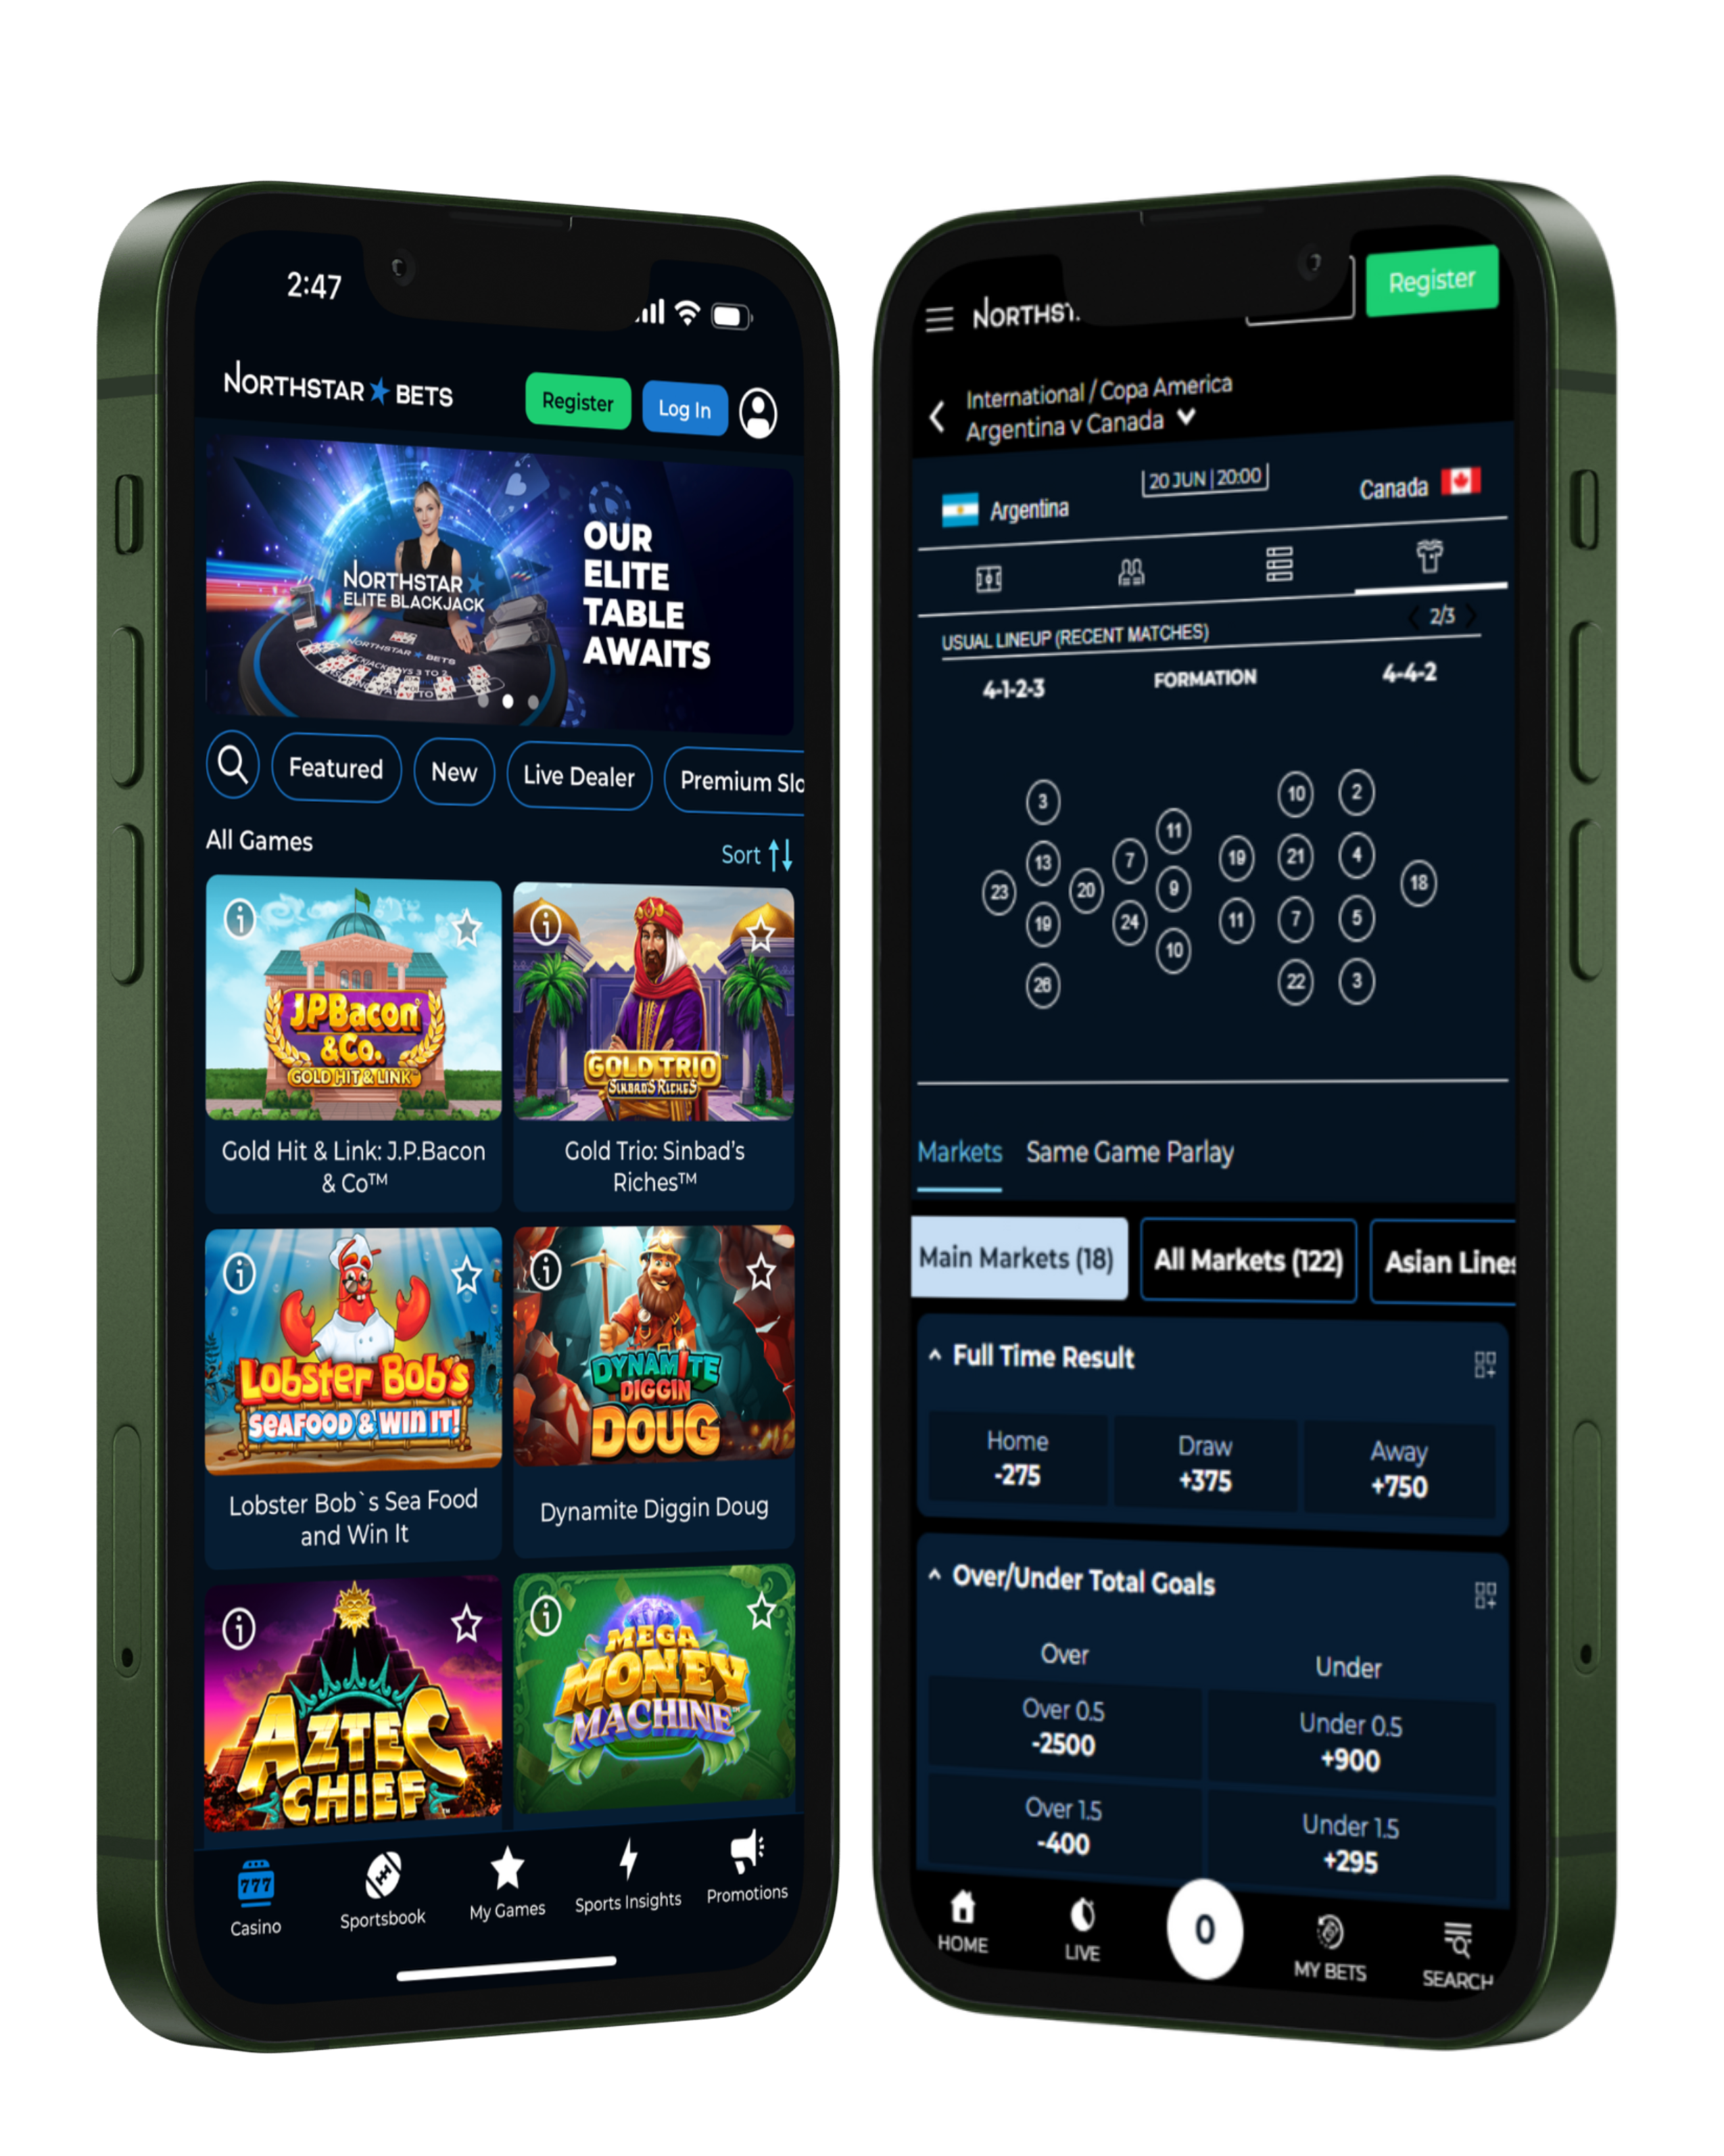
PRIORITIES FOR CONTINUED
GROWTH

Slide 20
KEY AREAS OF FOCUS IN 2025-2026
2025-2026
Focus
Operational Excellence
Market Expansion
Strategic Partnerships
Product Innovation

Slide 21
CAPITALIZATION
Bitove &
Torstar Entities.⁴
Other Shareholders
205.8 million shares outstanding
Rivett &
Related Entities
Directors &
Senior Officers
Playtech
1. Weighted average strike price of $0.29
2. Weighted average strike price of $0.40
3. Debentures convertible at $0.20, 8% interest paid-in-kind
4. Torstar controlled by Jordan Bitove
* Source: Capital IQ February 14, 2025

