Slide 1

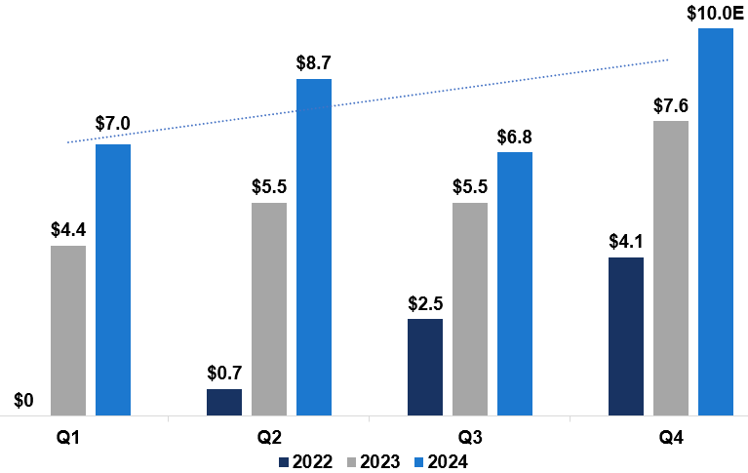

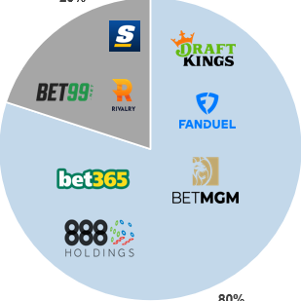
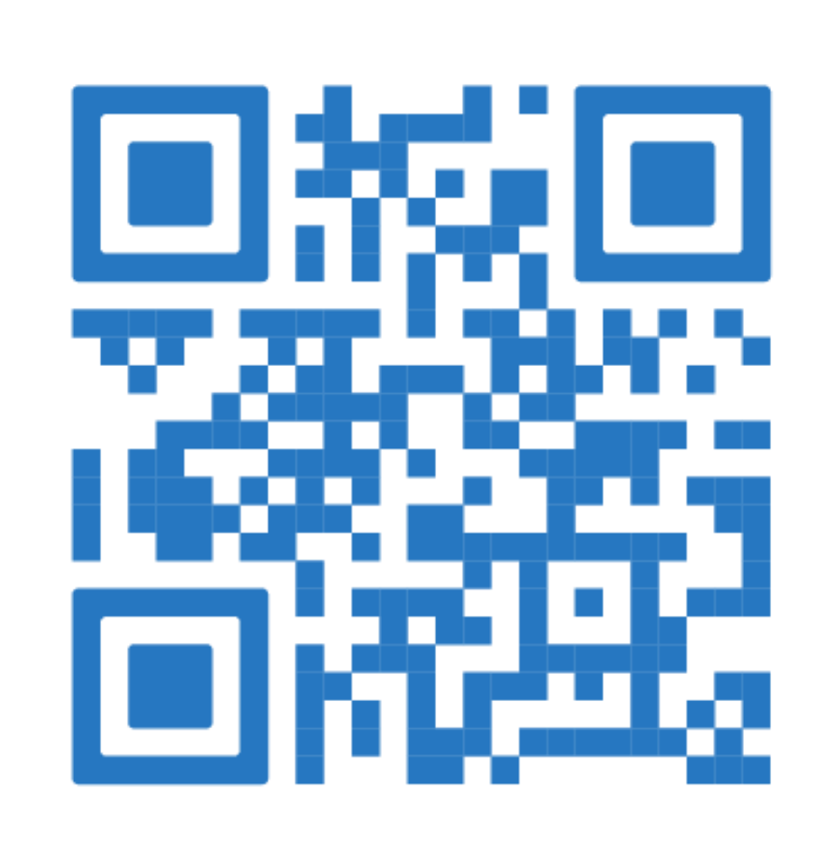



NorthStar Gaming is a uniquely positioned iGaming company combining sports media with sports wagering by leveraging strong partnerships and agreements with leading media companies.
TSXV: BET | OTCQB: NSBBF Fact Sheet February 2025
Share Structure (as of Feb 14, 2025)
Key Highlights
~C$8.5B Canadian TAM exposed to NorthStar brand, with Ontario’s regulated market launched in April 2022 and branch launch of NorthStarBets.com in November 2023
Industry leading gaming content and technology
Funding in place to reach profitability based on current business platform
Experienced management team with local knowledge and insights targeting the Canadian audience
Differentiated positioning as a premium offering leading to a superior customer experience and user economics
Variable cost model fully aligning incentives amongst vendors and NorthStar Gaming
Market Value @ C$0.08 | C$16.5 M
52 Week SP Range | C$0.02 - 0.105
Shares Outstanding | 205.8 M
Warrants (WAVG C$0.40) | 87.4 M
Options (WAVG C$0.29) | 17.7 M
Fully Diluted | 310.9 M
Ownership
Management & Board | 10.2%
Playtech PLC | 25.8%
Torstar / Jordan Bitove | 17.5%
Rivett & Related Entities | 12.2%
Total Gross Gaming Revenue (C$ Millions)
Management & Board
Michael Moskowitz
CEO & Chairman
Chin Dhushenthen
CFO
Corey Goodman
CDO and General Counsel
Maureen Rydzik
VP IT and Vendor Management
Dante Anderson
VP Marketing
Gil Steinfeld
Strategic Advisor
Well Positioned to Compete in Ontario and the Rest of Canada
FY2025E Market Share
Niche Operators Top 5 Operators
NorthStar Gaming Holdings Inc.
220 King St W, Suite 200
Toronto, ON M5H 1K4, Canada
www.northstargaming.ca
20%
FY2025E market share for Niche Operators ~C$1.5B
NorthStar well positioned to grow Ontario market share and across Canada
3% of market share would equate to >C$200M revenue
80%
NorthStar Gaming Investor Relations
RB Milestone Group LLC (RBMG)
northstar@rbmilestone.com
linkedin.com/company/northstar-gaming
twitter.com/NorthStarBet
facebook.com/NorthStarBets

Slide 2
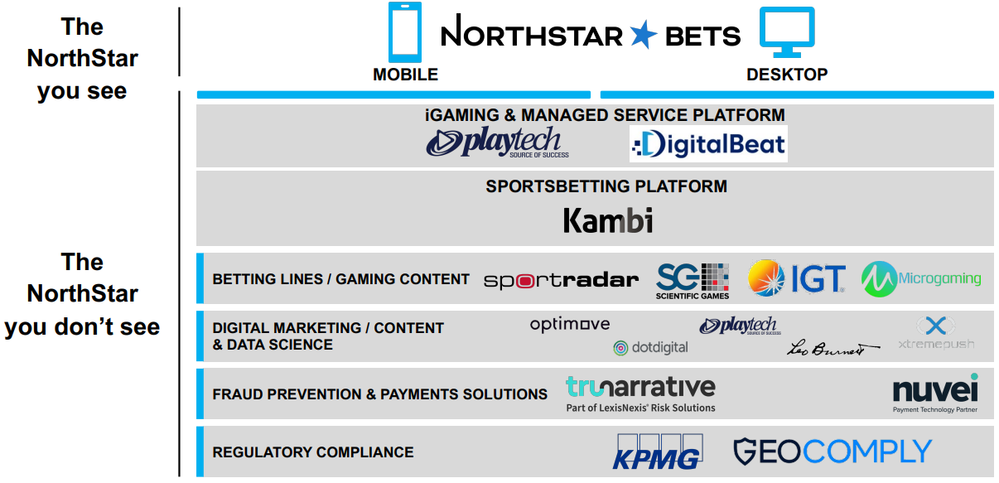
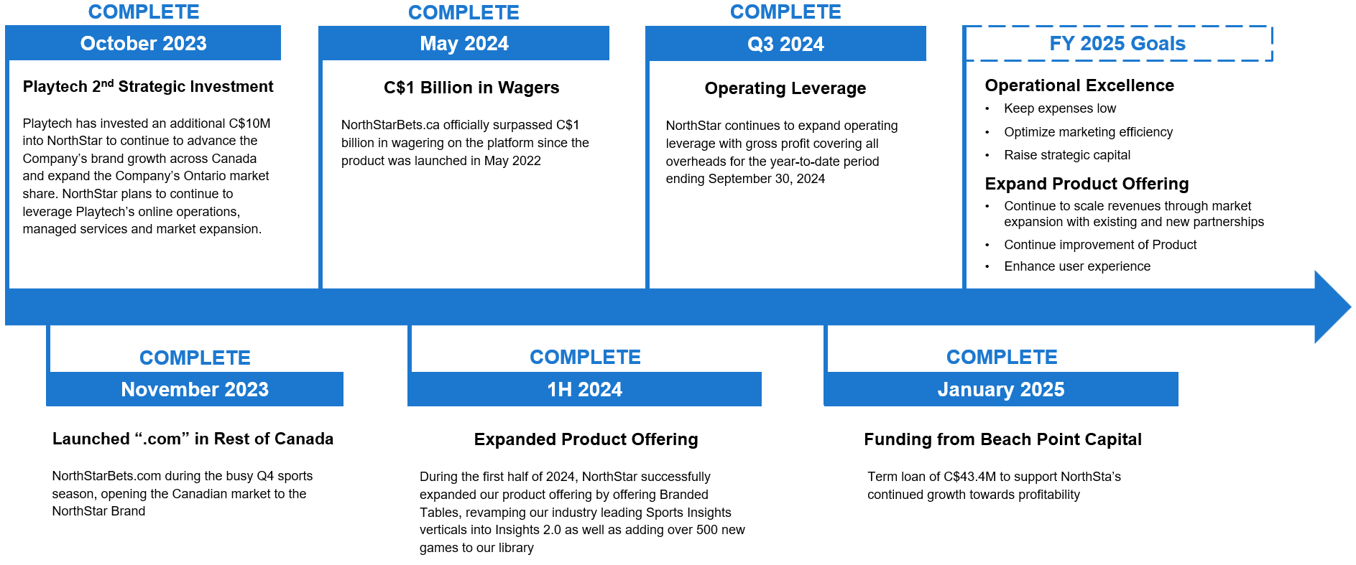
Spearheading the intersection of
iGaming and Media
TSXV: BET | OTCQB: NSBBF Fact Sheet February 2025
Key Milestones
DISCLAIMER: The information contained in this presentation has been prepared by NorthStar Gaming Inc. (the “Company”) and contains confidential information pertaining to the business and operations of the Company. The information contained in this presentation: (a) is provided as at the date hereof, is subject to change without notice, and is based on publicly available information, internally developed data as well as third party information from other sources; (b) is not to be considered as a recommendation by the Company that any person make an investment in the Company; and (c) is for information purposes only. Where any opinion or belief is expressed in this presentation, it is based on certain assumptions and limitations and is an expression of present opinion or belief only. Third party information has not been independently verified by the Company, but it believes that the information was obtained from reliable sources and has no reason to believe it is not accurate in all material respects. No warranties or representations can be made as to the origin, validity, accuracy, completeness, currency or reliability of the information. The Company disclaims and excludes all liability (to the extent permitted by law), for losses, claims, damages, demands, costs and expenses of whatever nature arising in any way out of or in connection with the information in this presentation, its accuracy, completeness or by reason of reliance by any person on any of it.

